Slide 1
Message Authentication & Hash Functions
Notes:
1
Opening quote.

Slide 2
Message Authentication
Message authentication is concerned with:
Protecting the integrity of a message
Validating identity of originator
Non-repudiation of origin (dispute resolution)
Will consider the security requirements
Then three alternative functions used:
Message encryption
Message authentication code (MAC)
Hash function
Notes:
2
Up untill now, have been concerned with protecting message content (ie secrecy) by encrypting the message. Will now consider how to protect message integrity (ie protection from modification), as well as confirming the identity of the sender. Generically this is the problem of message authentication, and in eCommerce applications is arguably more important than secrecy. Message Authentication is concerned with: protecting the integrity of a message, validating identity of originator, & non-repudiation of origin (dispute resolution). There are three types of functions that may be used to produce an authenticator: message encryption, message authentication code (MAC), or a hash function.

Slide 3
Security Requirements
Disclosure
Traffic analysis
Masquerade
Content modification
Sequence modification
Timing modification
Source repudiation
Destination repudiation
Notes:
3
In the context of communications across a network, the attacks listed above can be identified.
The first two requirements belong in the realm of message confidentiality, and are handled using the encryption techniques already discussed.
The remaining requirements belong in the realm of message authentication. At its core this addresses the issue of ensuring that a message comes from the alleged source and has not been altered. It may also address sequencing and timeliness. The use of a digital signature can also address issues of repudiation by the source.

Slide 4
Authentication Functions
Any message authentication or digital signature mechanism has two levels of functionality
Function that produces an authenticator: a value to be used to authenticate a message.
Lower-level function used as a primitive in a higher-level authentication protocol that enables a receiver to verify the authenticity of a message
Message encryption: The ciphertext of the entire message serves as its authenticator
Message authentication code (MAC): A function of the message and a secret key that produces a fixed-length value that serves as the authenticator
Hash function: A function that maps a message of any length into a fixed-length hash value, which serves as the authenticator

Slide 5
Message Encryption
Message encryption provides a measure of authentication
If symmetric encryption is used then:
Receiver know sender must have created it
Since only sender and receiver know key used
Content cannot altered by unauthorized users
If message has suitable structure, redundancy or a checksum to detect any changes
Notes:
5
Message encryption by itself can provide a measure of authentication. Here, the ciphertext of the entire message serves as its authenticator, on the basis that only those who know the appropriate keys could have validly encrypted the message. This is provided you can recognize a valid message (ie if the message has suitable structure such as redundancy or a checksum to detect any changes).

Slide 6
Message Encryption
If public-key encryption is used:
Encryption provides no confidence of sender
Since anyone potentially knows public-key
However if
Sender signs message using their private-key
Then encrypts with recipients public key
Have both secrecy and authentication
Again need to recognize corrupted messages
But at cost of two public-key uses on message
Notes:
6
With public-key techniques, can get a digital signature which can only have been created by key owner. But at cost of two public-key operations at each end on message.

Slide 7
Message Authentication Code (MAC)
Generated by an algorithm that creates a small fixed-sized block
Depending on both message and some key
Like encryption though need not be reversible
Appended to message as a signature
Receiver performs same computation on message and checks it matches the MAC
Provides assurance that message is unaltered and comes from sender
Notes:
7
An alternative authentication technique involves the use of a secret key to generate a small fixed-size block of data, known as a cryptographic checksum or MAC that is appended to the message. This technique assumes that two communicating parties, say A and B, share a common secret key K. A MAC function is similar to encryption, except that the MAC algorithm need not be reversible, as it must for decryption.

Slide 8
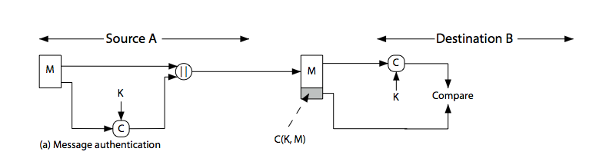
Message Authentication Code
Notes:
8
Stallings Figure 11.4a “Message Authentication” shows the use of a MAC just for authentication.

Slide 9
Message Authentication Codes
MAC provides authentication
Can also use encryption for secrecy
Generally use separate keys for each
Can compute MAC either before or after encryption
Is generally regarded as better done before
Why use a MAC?
Sometimes only authentication is needed
Sometimes need authentication to persist longer than the encryption (eg. Archival use)
Note: MAC is not a digital signature
Notes:
9
Can combine use of MAC with encryption in various ways to provide both authentication & secrecy.
Use MAC in circumstances where just authentication is needed (or needs to be kept), see text for examples.
A MAC is NOT a digital signature since both sender & receiver share key and could create it.

Slide 10
MAC Properties
A MAC is a cryptographic checksum
MAC = C_{K}(M)
Condenses a variable-length message M
Using a secret key K
To a fixed-sized authenticator
Is a many-to-one function
Potentially many messages have same MAC
But finding these needs to be very difficult
Notes:
10
A MAC, also known as a cryptographic checksum,is generated by a function C. The MAC is appended to the message at the source at a time when the message is assumed or known to be correct. The receiver authenticates that message by re-computing the MAC.
The MAC function is a many-to-one function, since potentially many arbitrarily long messages can be condensed to the same summary value, but don’t want finding them to be easy!

Slide 11
Requirements for MACs
Taking into account the types of attacks
Need the MAC to satisfy the following:
Knowing a message and MAC, is infeasible to find another message with same MAC
MACs should be uniformly distributed
MAC should depend equally on all bits of the message
Notes:
11
In assessing the security of a MAC function, we need to consider the types of attacks that may be mounted against it. Hence it needs to satisfy the listed requirements.
The first requirement deals with message replacement attacks, in which an opponent is able to construct a new message to match a given MAC, even though the opponent does not know and does not learn the key.
The second requirement deals with the need to thwart a brute-force attack based on chosen plaintext.
The final requirement dictates that the authentication algorithm should not be weaker with respect to certain parts or bits of the message than others.

Slide 12
Using Symmetric Ciphers for MACs
Can use any block cipher chaining mode and use final block as a MAC
Data authentication algorithm (DAA) is a widely used MAC based on DES-CBC
Using IV=0 and zero-pad of final block
Encrypt message using DES in CBC mode
And send just the final block as the MAC
Or the leftmost M bits (16≤M≤64) of final block
But final MAC is now too small for security
Notes:
12
Can also use block cipher chaining modes to create a separate authenticator, by just sending the last block. This was done with the Data Authentication Algorithm (DAA), a widely used MAC based on DES-CBC (next slide). However this suffers from being too small for acceptable use today.

Slide 13
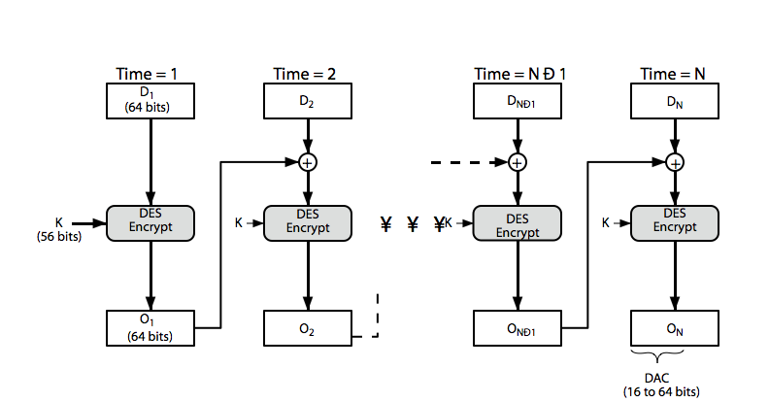
Data Authentication Algorithm
Notes:
13
Stallings Figure 11.6 “Data Authentication Algorithm”, illustrates the FIPS PUB 113 / ANSI X9.17 MAC based on DES-CBC with IV 0 and 0-pad of the final block if needed. Resulting MAC can be 16-64 bits of the final block. But this is now too small for security.

Slide 14
Hash Functions
Condenses arbitrary message to fixed size
h = H(M)
Usually assume that the hash function is public and not keyed
MAC which is keyed
Hash used to detect changes to message
Can use in various ways with message
Most often to create a digital signature
Notes:
14
A variation on the message authentication code is the one-way hash function. As with the message authentication code, a hash function accepts a variable-size message M as input and produces a fixed-size output, referred to as a hash code H(M). Unlike a MAC, a hash code does not use a key but is a function only of the input message. The hash code is also referred to as a message digest or hash value.

Slide 15
Hashing V.S. Encryption
Hello, world.
A sample sentence to show encryption.
k
E
NhbXBsZSBzZW50ZW5jZSB0byBzaG93IEVuY3J5cHRpb24KsZSBzZ
Hello, world.
A sample sentence to show encryption.
D
k
NhbXBsZSBzZW50ZW5jZSB0byBzaG93IEVuY3J5cHRpb24KsZSBzZ
Encryption is two way, and requires a key to encrypt/decrypt
This is a clear text that can easily read without using the key. The sentence is longer than the text above.
h
52f21cf7c7034a20 17a21e17e061a863
Hashing is one-way. There is no 'de-hashing’

Slide 16
Hash Function Applications
Used Alone
Fingerprint -- file integrity verification, public key fingerprint
Password storage (one-way encryption)
Combined with encryption functions
Hash based Message Authentication Code (HMAC)
protects both a message's integrity and confidentiality
Digital signature
Ensuring Non-repudiation
Encrypt hash with private (signing) key and verify with public (verification) key
Notes:
16

Slide 17
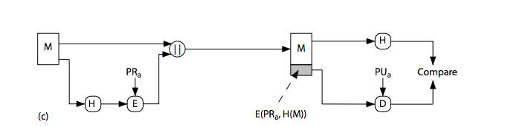
Hash Functions & Digital Signatures
Notes:
17
Stallings Figure 11.5c “Basic Uses of Hash Functions” shows the hash being “signed” with the senders private key, thus forming a digital signature.

Slide 18
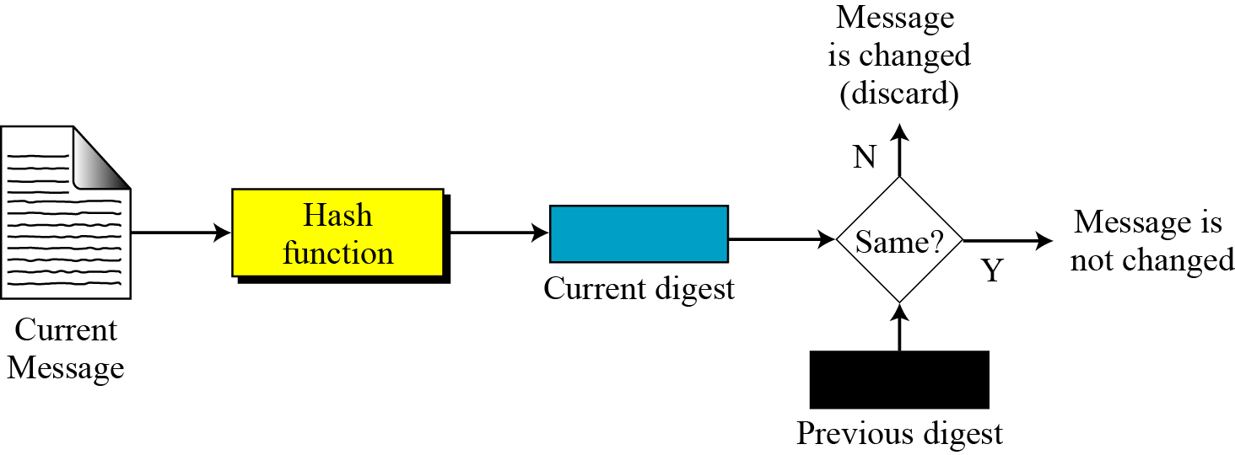
Integrity
To create a one-way password file
Store hash of password not actual password
For intrusion detection and virus detection
Keep & check hash of files on system
Notes:
Hash functions are commonly used to create a one-way password file. Chapter 20 explains a scheme in which a hash of a password is stored by an operating system rather than the password itself. Thus, the actual password is not retrievable by a hacker who gains access to the password file. In simple terms, when a user enters a password, the hash of that password is compared to the stored hash value for verification. This approach to password protection is used by most operating systems.
Hash functions can be used for intrusion detection and virus detection. Store H(F) for each file on a system and secure the hash values (e.g., on a CD-R that is kept secure). One can later determine if a file has been modified by recomputing H(F). An intruder would need to change F without changing H(F).
A cryptographic hash function can be used to construct a pseudorandom function (PRF) or a pseudorandom number generator (PRNG). A common application for a hash-based PRF is for the generation of symmetric keys. We discuss this application in Chapter 12.
18

Slide 19
Password Verification
Store Hashing Password
Verification an input password against the stored hash
Iam#4VKU
Iam#4VKU
Password store
h
h
661dce0da2bcb2d8 2884e0162acf8194
661dce0da2bcb2d8 2884e0162acf8194
661dce0da2bcb2d8 2884e0162acf8194
Hash Matching Exactly?
Password store
Yes
No
Grant
Deny

Slide 20
Requirements for Hash Functions
Can be applied to any sized message M
Produces fixed-length output h
Easy to compute h=H(M) for any message M
Given h is infeasible to find x s.t. H(x)=h
one-way property
Given x is infeasible to find y s.t. H(y)=H(x)
weak collision resistance
Infeasible to find any x,y s.t. H(y)=H(x)
strong collision resistance
Notes:
20
The purpose of a hash function is to produce a “fingerprint”of a file, message, or other block of data.
These are the specifications for good hash functions. Essentially it must be extremely difficult to find 2 messages with the same hash, and the hash should not be related to the message in any obvious way (ie it should be a complex non-linear function of the message). There are quite a few similarities in the evolution of hash functions & block ciphers, and in the evolution of the design requirements on both.

Slide 21
Properties : Fixed length
Hello, world
h
661dce0da2bcb2d8 2884e0162acf8194
Fixed length L
This is a clear text that can easily read without using the key. The sentence is longer than the text above.
h
52f21cf7c7034a20 17a21e17e061a863
Arbitrary-length message to fixed-length digest

Slide 22
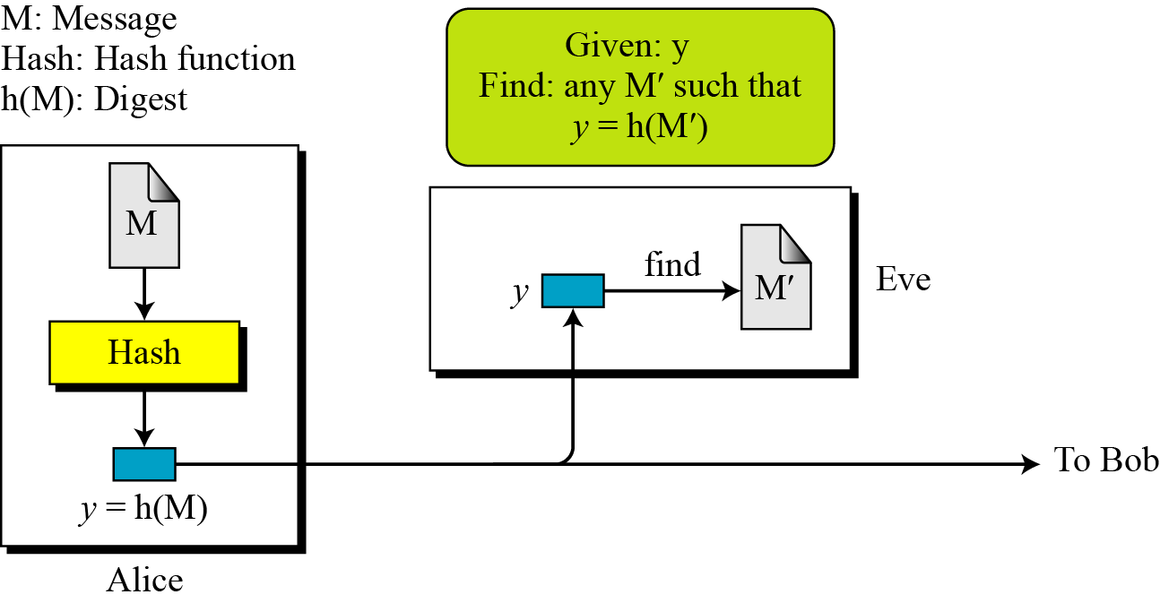
Preimage resistant
This measures how difficult to devise a message which hashes to the known digest
Roughly speaking, the hash function must be one-way.
Given only a message digest, can’t find any message (or preimage) that generates that digest.
Notes:
Exploiting weak preimage resistance: If we are able to "work backwards" from a hash and create some text that produces the same hash, we can use this to beat hashed passwords. We won't ever know the actual input data that was used, but that doesn't matter. Looking at the flow for validating against hashed passwords, all that matters is that the hashes match, not the passwords, so if we can findany other text that produces the stored hash, we'll be granted access. "Collisions" mean "more than one password will be accepted".
22

Slide 23
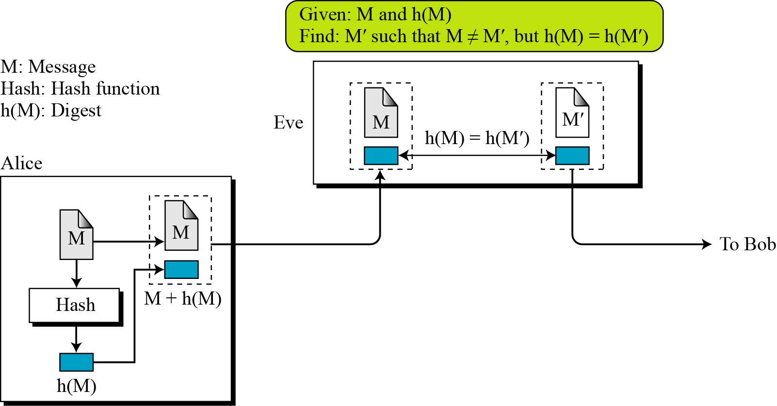
Second preimage resistant
This measures how difficult to devise a message which hashes to the known digest and its message
Given one message, can’t find another message that has the same message digest. An attack that finds a second message with the same message digest is a second pre-image attack.
It would be easy to forge new digital signatures from old signatures if the hash function used weren’t second preimage resistant
Notes:
This seems like a somewhat easier case of the previous item: the goal is to produce a new input that generates the given hash, but this time we know the original text that created it. Exploiting second weak preimage resistance: As with preimage resistance, we want to fool somebody into authenticating our data as genuine, and we'd most likely use this when trying to introduce a corrupted software distribution.We saw that many other organizations publishes software and matching md5 checksums, and if we are able to maliciously modify the source code but nevertheless keep the same checksum, downloaders around the globe will accept badware as genuine.
23

Slide 24
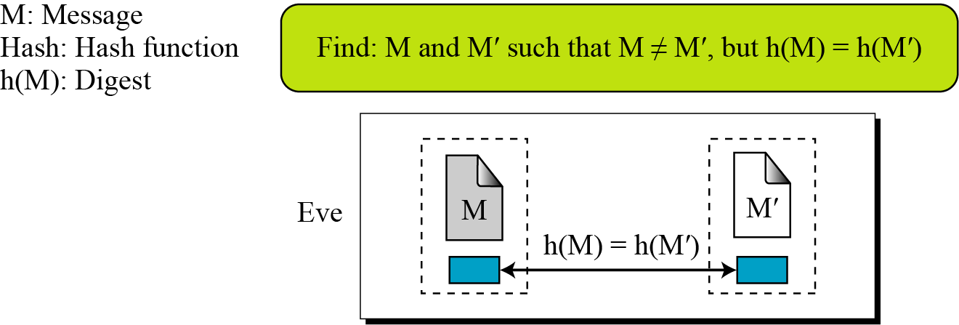
Collision Resistant
Can’t find any two different messages with the same message digest
Collision resistance implies second preimage resistance
Collisions, if we could find them, would give signatories a way to repudiate their signatures

Slide 25
Simple Hash Functions
Are several proposals for simple functions
Based on XOR of message blocks
Not secure since can manipulate any message and either not change hash or change hash also
Need a stronger cryptographic function
Notes:
25
All hash functions operate using the following general principles. The input (message, file,etc.) is viewed as a sequence of n-bit blocks, processed one block at a time in an iterative fashion to produce an n-bit hash function. Can construct a range of possible simple hash functions by just XOR’ing blocks with rotates etc. None of these are secure, since can predict how changes to message affect the resulting hash.

Slide 26
Birthday Attacks
Might think a 64-bit hash is secure
But by Birthday paradox is not
Birthday attack works thus:
Opponent generates 2^{m/2} variations of a valid message all with essentially the same meaning
Opponent also generates 2^{m/2} variations of a desired fraudulent message
Two sets of messages are compared to find pair with same hash (probability > 0.5 by birthday paradox)
Have user sign the valid message, then substitute the forgery which will have a valid signature
Conclusion is that need to use larger MAC/hash
Notes:
26
The Birthday Attack exploits the birthday paradox – the chance that in a group of people two will share the same birthday – only 23 people are needed for a Pr>0.5 of this. Can generalize the problem to one wanting a matching pair from any two sets, and show need 2^{m/2} in each to get a matching m-bit hash.
Note that creating many message variants is relatively easy, either by rewording or just varying the amount of white-space in the message. All of which indicates that larger MACs/Hashes are needed.

Slide 27
Block Ciphers as Hash Functions
Can use block ciphers as hash functions
Using H₀=0 and zero-pad of final block
Compute: h_{i} = e_{mi} [h_{i-1}]
And use final block as the hash value
Similar to CBC but without a key
Resulting hash is too small (64-bit)
Both due to direct birthday attack
And to “meet-in-the-middle” attack
Other variants also susceptible to attack
Notes:
27
A number of proposals have been made for hash functions based on using a cipher block chaining technique, but without the secret key (instead using the message blocks as keys). Unfortunately these are subject to both the birthday attack, and to a “meet-in-the-middle” attack. Thus, attention has been directed at finding other approaches to hashing.

Slide 28
Hash Functions & MAC Security
like block ciphers have:
brute-force attacks exploiting
strong collision resistance hash have cost 2^{m/2}
have proposal for h/w MD5 cracker
128-bit hash looks vulnerable, 160-bits better
MACs with known message-MAC pairs
can either attack keyspace (cf key search) or MAC
at least 128-bit MAC is needed for security
Notes:
28
Just as with symmetric and public-key encryption, we can group attacks on hash functions and MACs into two categories: brute-force attacks and cryptanalysis.
The strength of a hash function against brute-force attacks depends solely on the length of the hash code produced by the algorithm, with cost O(2^m/2). See proposal in text for a h/w MD5 cracker.
A brute-force attack on a MAC is a more difficult undertaking because it requires known message-MAC pairs. However analysis shows cost is related to min(2^k, 2^n), similar to symmetric encryption algorithms.

Slide 29
Hash Functions & MAC Security
Cryptanalytic attacks exploit structure
Like block ciphers want brute-force attacks to be the best alternative
Have a number of analytic attacks on iterated hash functions
Cv_{i} = f[cv_{i-1}, m_{i}]; H(M)=CV_{N}
Typically focus on collisions in function f
Like block ciphers is often composed of rounds
Attacks exploit properties of round functions
Notes:
29
As with encryption algorithms, cryptanalytic attacks on hash functions and MAC algorithms seek to exploit some property of the algorithm to perform some attack other than an exhaustive search. The way to measure the resistance of a hash or MAC algorithm to cryptanalysis is to compare its strength to the effort required for a brute-force attack. That is, an ideal hash or MAC algorithm will require a cryptanalytic effort greater than or equal to the brute-force effort.
Cryptanalysis of hash functions focuses on the internal structure of the compression function f and is based on attempts to find efficient techniques for producing collisions for a single execution of f. Keep in mind that for any hash function there must exist collisions, but want it to be computationally infeasible to find these collisions.

Slide 30
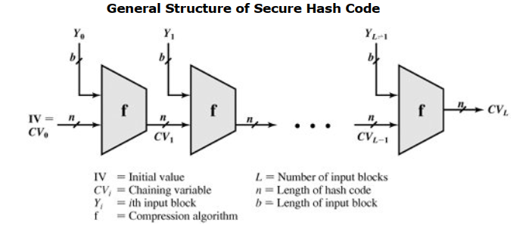

Slide 31
Summary
Have considered message authentication using:
Message encryption
Macs
Hash functions
General approach & security
Notes:
31
Chapter 11 summary.

